Slide 1

Tourism and hospitality opportunities in Morocco
Moroccan Agency for tourism Development / SMIT
October 2017

Slide 2
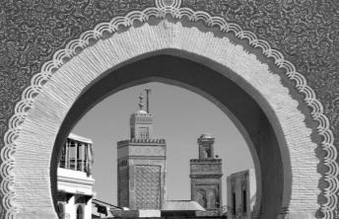
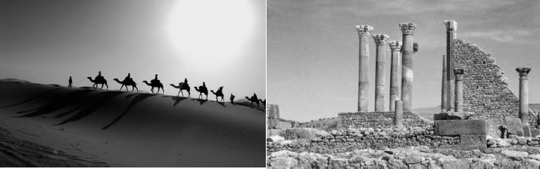
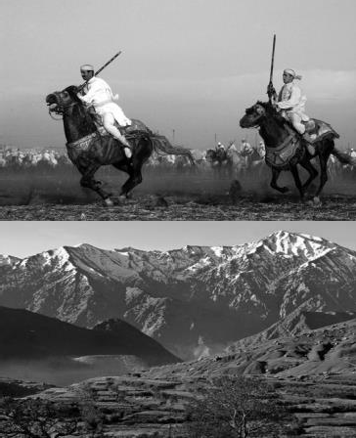
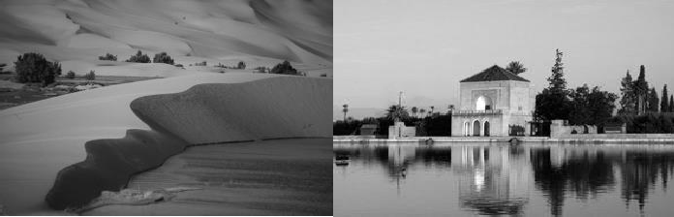
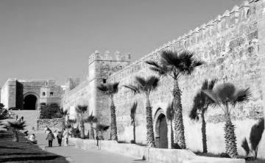
MARKETING- Réalisation 1er Semestre 2017
INTRODUCING SMIT

Slide 3


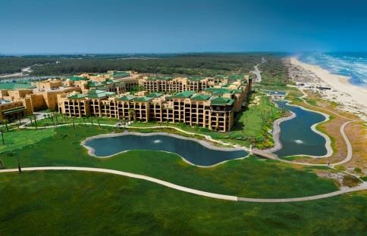





S.M.I.T. Business scope
S.M.I.T. is the Moroccan Government’s tourism development agency in charge of implementing Morocco’s tourism development strategy
MISSION
Identifying investment opportunities through industry intelligence
Developing innovative, competitive and profitable tourism concepts
Advice on preferential zoning and land mobilization
ENGINEERING
Introducing investors to key officials and operators
Project follow-up and Investors aftercare
Facilitating government approvals and providing support on incentives programs

Slide 4


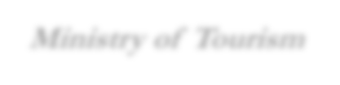
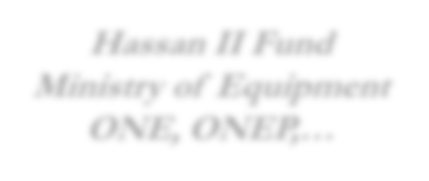






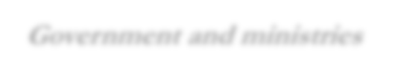
















Government involvement in tourism industry
Central entities in charge of tourism development in Morocco
Other central entities with a significant contribution
Ministry of Tourism
CENTRAL LEVEL
Hassan II Fund, FDII, ONE, ONEP,…
Defining the Moroccan tourism strategy
Regulations
Financing investment incentives
Morocco tourism board / ONMT
Tourism development Agency / SMIT
AMDI / Invest in Morocco
Cross industries investments promotion
Marketing Destination Morocco to tourists / B2C
Indicators :
Tourists arrivals
Tourism receipts & revenues
Promotion of the destination to investors and operators / B2C
Indicators :
Investments in tourism (FDI)
Room Capacity
Government and ministries
Approval for incentives
LOCAL
LEVEL
Regional Tourism Delegation (DRT)
Regional Center of Investment (CRI)
Cities councils, Wilayas …

Slide 5
MARKETING- Réalisation 1er Semestre 2017
WHY INVEST IN TOURISM IN MOROCCO ?

Slide 6
WHY TOURISM IN MOROCCO ?
A RISING DESTINATION WITH STILL UNTAPPED POTENTIAL
Resilient destination
Unequaled Tourism potential
Top priority for the Government
Secure, safe and stable environment
Robust infrastructures
Investors-friendly environment

Slide 7



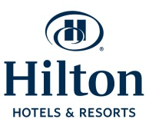
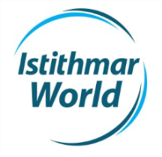
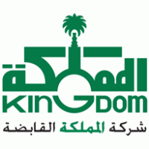
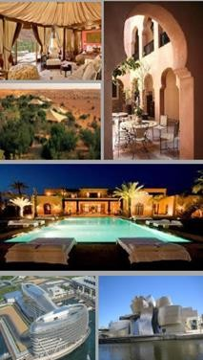



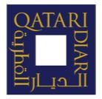




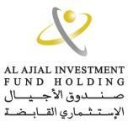
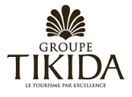

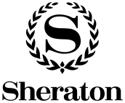
WHY TOURISM IN MOROCCO ?
Tourism in Morocco has shown strong resilience over the past years
World Class Brands
Top Tourism Investors
world class destination
Morocco is ranked Africa’s destination n°1 in terms of tourists arrivals …
and n°1 in terms of investment attractiveness in 2016

Slide 8
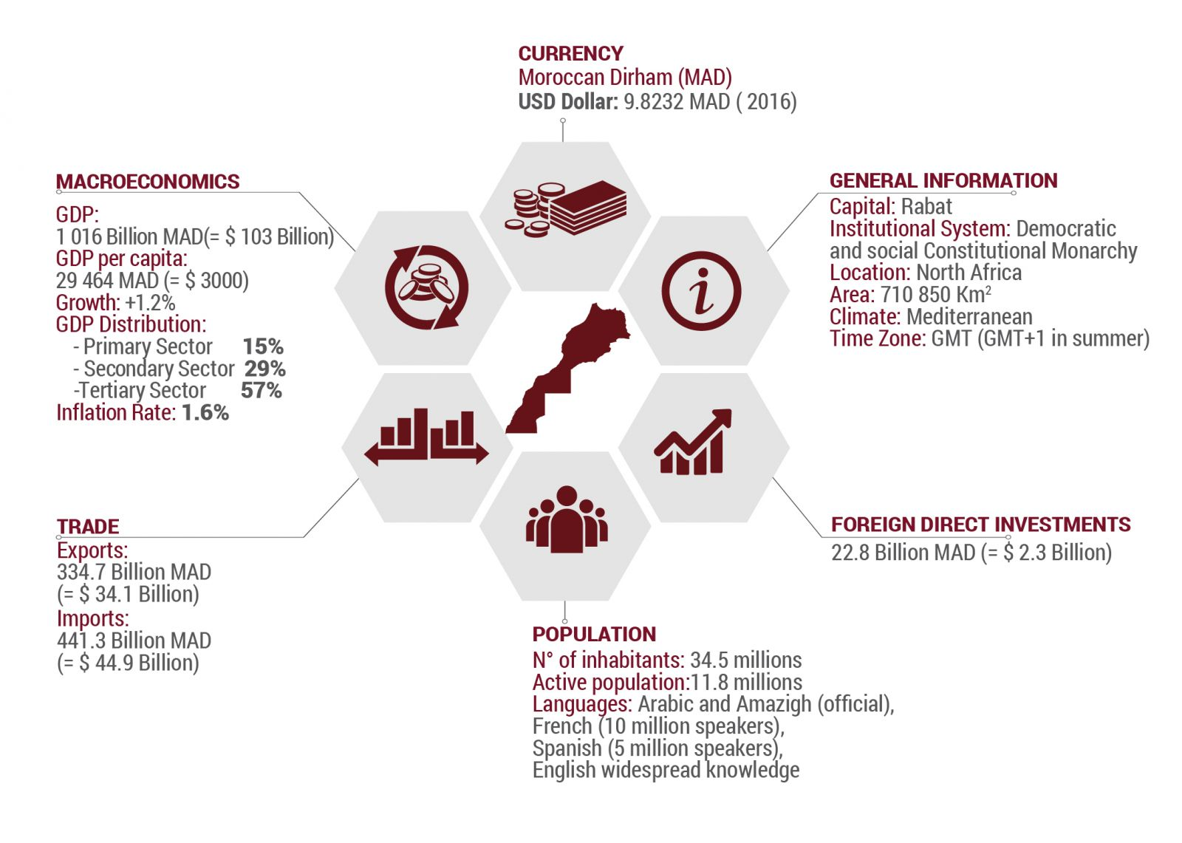
WHY TOURISM IN MOROCCO ?
A secure, safe and stable environment
Despite the global economic crisis, Morocco has shown strong resilience with an encouraging GDP average annual growth of 4,5% since 2010.
Morocco economy is diversified and relies on Renewable energy, phosphates, food business and tourism. Despite the turmoil in the MENA region, tourists arrivals never fell in Morocco.
Unemployment rate has dropped below 10% for the 9th year in a row.

Slide 9
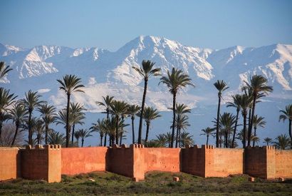
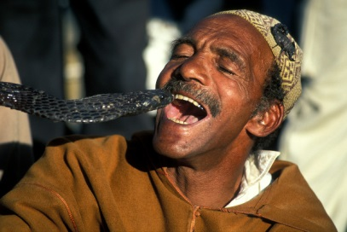
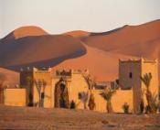
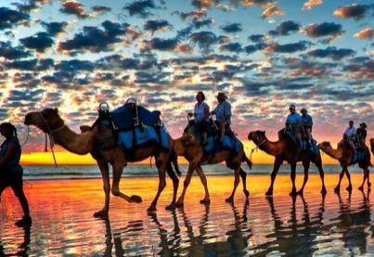
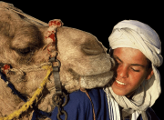
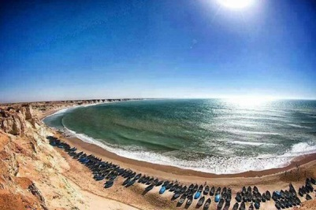
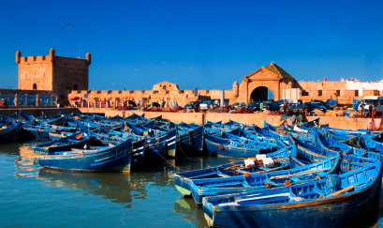
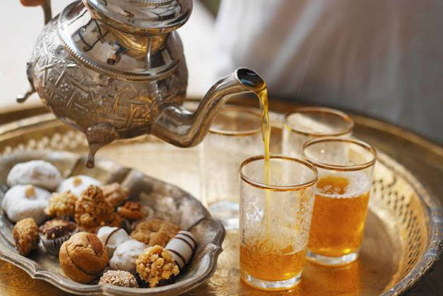
WHY TOURISM IN MOROCCO ?
AN UNPARALLELED POTENTIAL
PERFECT WEATHER ALL YEAR LONG
Warm winters in the inland … and cool summers in the coastline
A MIXED AND VIBRANT CULTURE
A singular Moorish identity with African and European influences
EXCEPTIONAL MONUMENTS
Imperial cities, palaces, souks, Kasbahs, medieval towns, renowned culinary art and craft industry
STUNNING LANDSCAPRES
3,500 Km of coastlines, large rivers and lakes, Atlas Mountains, Sahara desert outback…
A LONG TRADITION OF HOSPITALLITY
Morocco is amongst the world’s 3 most welcoming countries according to the Washington Post
AN ESTABLISHED BRAND WORLDWIDE
Who’s never heard of Casablanca, Marrakech, Moroccan mint tea and Couscous ?

Slide 10
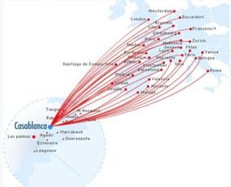
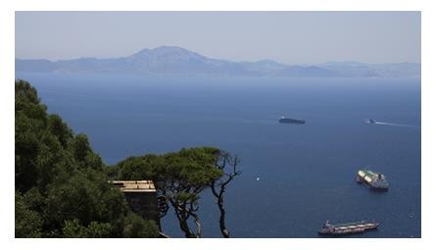
WHY TOURISM IN MOROCCO ?
A STRATEGIC LOCATION AT THE GATES OF EUROPE
Spain as seen from … Tangier
Morocco is an easy access destination : Less than 3 hours Flights away European capitals making it the ideal destination for short holiday breaks
Direct connections with more than 32 European cities and 18 African cities
Royal Air Maroc has beaten a record of 55 000 transported passengers for the month of August 2015 and with forecasts of stronger loads and yields on Moroccan routes, airline capacity in Morocco is predicted to increase by 50 per cent in the next few years

Slide 11
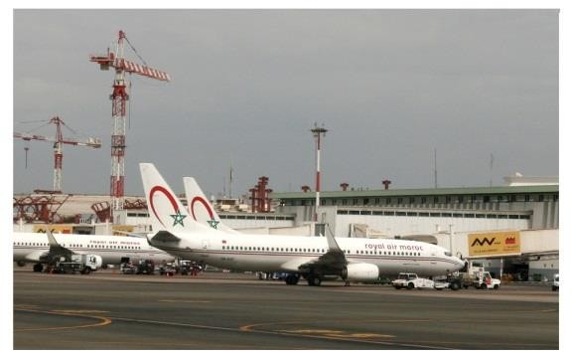
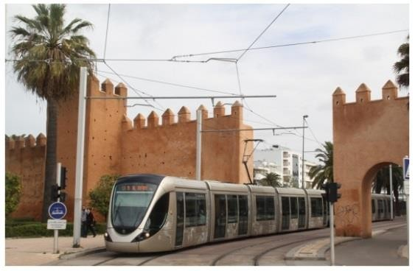
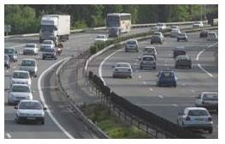
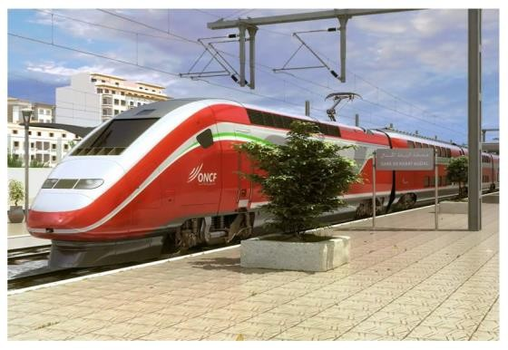
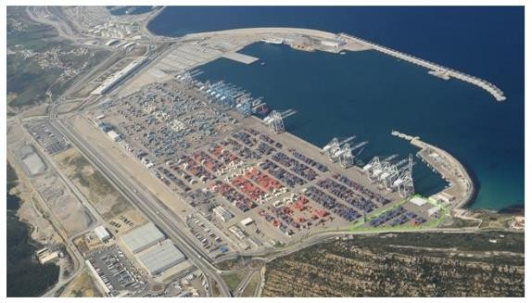
WHY TOURISM IN MOROCCO ?
ROBUST INFRASTRUCTURES
17 international Airports
Modern urban transport infrastructures
#1 Africa – Europe Hub
2 extensive tramways networks already operating
More than 2 000 km of Highways covering major tourism centers
High-speed railway : Casablanca-Tangier line to be opened by 2017
“Tangier Med” Port to be ranked amongst World top 15 harbors
Current capacity of 3 million containers
8.5 million containers capacity by 2017
Integrated offer of Industrial, Logistical and Commercial Zones with multimodal infrastructure

Slide 12
MARKETING- Réalisation 1er Semestre 2017
GOVERNMENT SUPPORT AND INCENTIVES

Slide 13
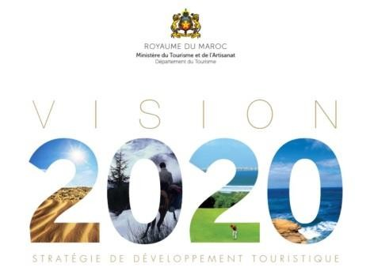
GOVERNMENT BACKING AND VISION 2020
Under the guidance of His Majesty King Mohammed VI, Morocco has launched “VISION 2020”, a set of very ambitious strategic objectives for tourism development :
Double the bed capacity with an additional 200 000 beds
Double the number of international tourists arrivals and triple the number of domestic trips
Double employment in tourism
Increase tourism annual GDP to $15 bn
Direct implication
Direct involvement of government officials and easy access to
minister of tourism and other key officials
Government also fosters involvement of the banking system : 3 Moroccan banks which are amongst the top-10 in Africa can propose efficient and tailored financing solutions for the Tourism Industry
Banking system

Slide 14
WHAT ARE THE INCENTIVES ?
Incentives granted through common law : tax exemptions
Total VAT exemption on capital expenditures
    Scope : Goods, equipment and tooling for both items acquired in Morocco and those imported.
    Period : 36 months from company's inception date or building’s permit date in case the company engages in constructions.
    Extension of this period may be granted once for an additional period of 6 months.
Total corporate tax exemption
    Scope : on sales issued in foreign currencies.
    Period : first 5 years of the company’s operations.
Reduced Rate of 17.5% corporate tax :
    Scope : on sales issued in foreign currencies.
    Period : From the 6th year of the company’s operations on.
    Compared to a standard corporate tax rate of 30%.
Reduced VAT rate of 10% on sales (Vs. standard rate of 20%) :
    Scope : Accommodation / rooms sales.
    Period : unlimited.

Slide 15
WHAT ARE THE INCENTIVES ?
Incentives granted through agreement with the Government : cash contributions
Government cash contribution up to 50% of land value, within a limit of MAD 250 / Sqm
    Scope : lots located in the Azur Plan resorts.
    Timeframe : Paid once the development is completed.
    Funded through : Hassan II fund for Economic and Social Development.
➔ Funded through the Industrial Development and Investment Fund (FDII), the following incentives are granted :
Government cash contribution of up to 20% of private land value.
Government cash contribution to offsite infrastructure costs.
Government cash contribution of up to 20% of total staff training costs.
The sum of all of the above mentioned incentives cannot exceed 5% of the total amount of the investment program. The cap reaches 10% in certain emerging regions.
Total customs duties exemption on imported capital expenditures
    Scope : Imported goods, equipment and tooling items.
    Period : 36 months from company's inception date or building’s permit date in case the company engages in constructions.
    Extension of this period may be granted once for an additional period of 6 months.

Slide 16
WHAT ARE THE INCENTIVES ?
The tourism map in Morocco and the Azur plan resorts
Beach / Coastal tourism
Tamuda Bay
North Cape
Lixus
Saidia Med
Mediterranean
8 distinctive destinations
3 relevant positioning
1 prevailing positioning per region
Mazagan
Central Atlantic
Central
Mogador
Marrakesh
Atlas & Valeys
Taghazout Bay
Oued Chbika
Souss Sahara
Cultural / Heritage tourism
Great South
Nature / Eco tourism

Slide 17
WHAT ARE THE INCENTIVES ?
Other financing support
Attractive pricing for prime location land parcels.
Central Guaranty Fund :
    Scope : The objective of the fund is to guarantee medium- and long-term bank loans that are granted to hotels and other tourism accommodation businesses and / or leisure projects.
    Guaranty : Up to 50% of the loan principal value with a maximum of MAD 50 M per project.
Renovotel :
    Scope : The objective of the fund is to guarantee medium- and long-term bank loans that are granted to refurbishment projects of hotels and accommodations businesses.
    Guaranty : Up to 60% of the loan principal value with a maximum of MAD 20 M per project.
Moussanadat assiyaha :
    Scope : Funding of Small to Medium enterprises in start up funds and staff recruitment costs.

Slide 18
A BUSINESS FRIENDLY ENVIRONEMENT
Easiness in setting up a business :
    Takes less than 10 days to incorporate a company.
No restrictions on capital investment :
    Non resident entities or individuals may up to own 100% of the capital of their businesses in Morocco.
Free repatriation of capital and profits :
    Non resident entities or individuals may transfer 100% of capital gains on divestment, profits and dividends.
No restrictions on land ownership :
    Except for lands dedicated to agriculture, non resident entities or individuals may own 100% of land deed.
No restrictions in terms of staff recruitments :
        Investors may recruit staff from any country without restrictions – especially senior staff.
    Member of the International Centre for Investment Disputes Settlement.

Slide 19
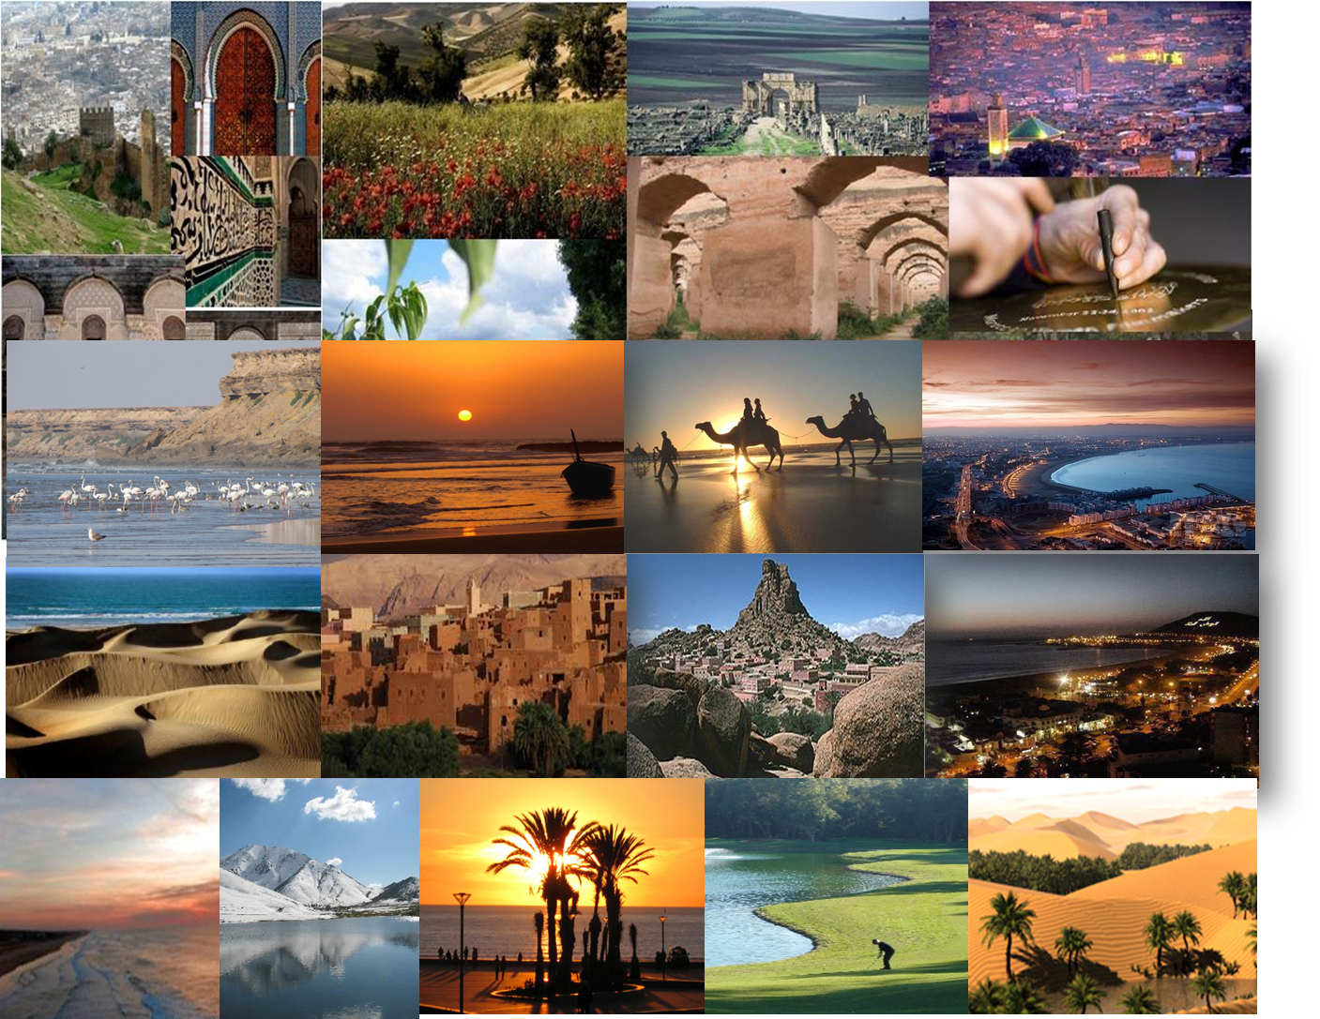

Slide 20
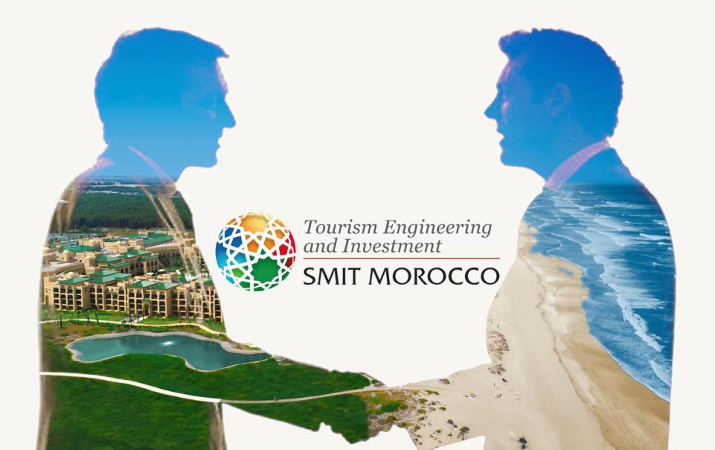
CONTACT US !
S.M.I.T. : THE PARTNER OF YOUR SUCCESS IN MOROCCO
Tel : (+212) 537 577 883/4
www.smit.gov.ma
Avenue Ennakhil
Hay Ryad Business Center
Rabat – Morocco
smikram@smit.gov.ma
yhajoui@smit.gov.ma

